Slide 1
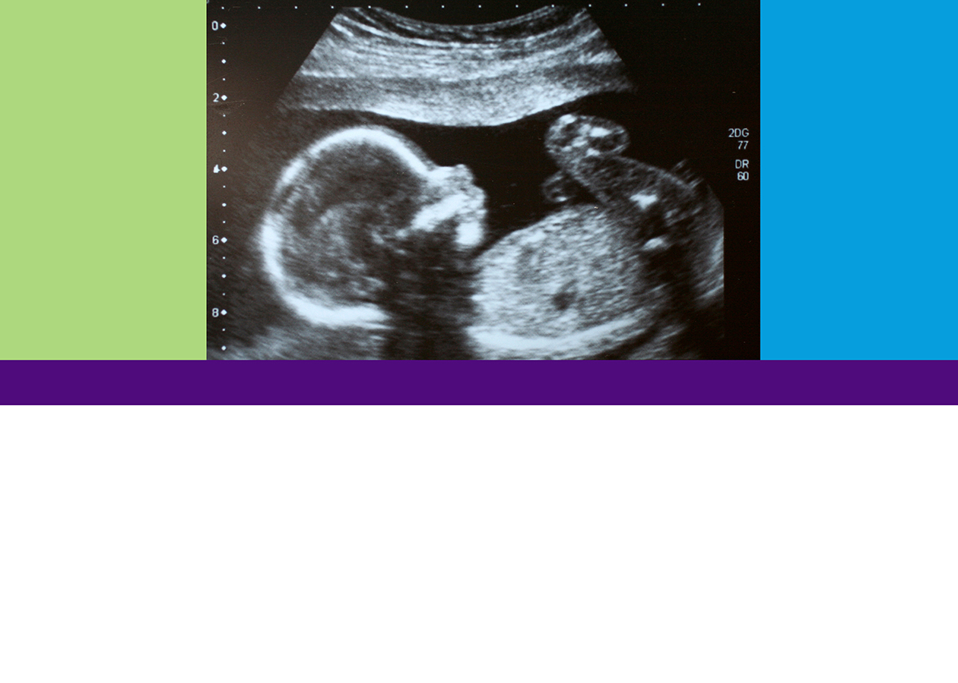
What is This?
Looking at Life in the Womb
TEEN EDITION
What Do You Say?
(What Can You Do?)
MODULE 6

Slide 2

Objective:
Formulate a personal answer to the question “What is this?” and develop a plan of action.

Slide 3
KLEW
Know | Learn | Evidence | Wonder
What did you Know?
What did you Learn
What Evidence do you have?
What Wonderings do you have? (questions you have and what you can do)

Slide 4


