Slide 1
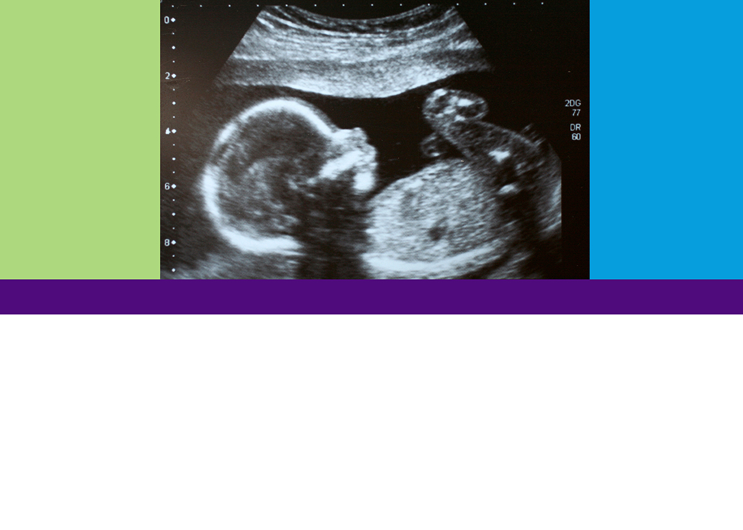
What is This?
Looking at Life in the Womb
TEEN EDITION
What Does Human Development Say?
MODULE 1

Slide 2

Objective:
Explore human growth and development from conception through adulthood and understand the changing characteristics and the timeline in which they occur.

Slide 3
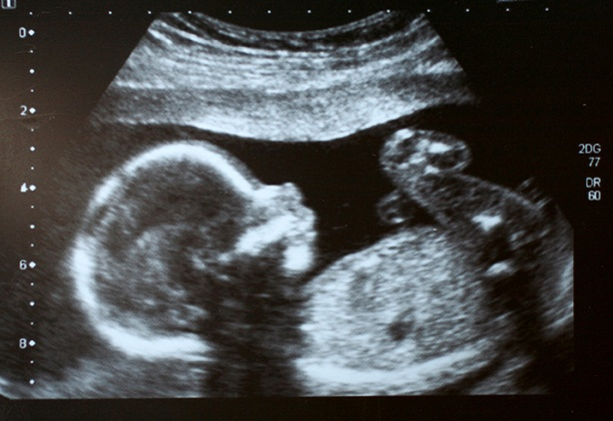

Look at the images on the following slides.
For each image answer the following questions:
What is it?
Why do you think so?
Images from: Mayo Clinic Healthy Lifestyle:
“Pregnancy Week by Week, Fetal Development: The 1st Trimester”, Mayo Clinic, Accessed 13 January 2015http://www.mayoclinic.org/healthy-living/pregnancy-week-by-week/in-depth/prenatal-care/art-20045302
“Pregnancy Week by Week, Fetal Development: The 2nd Trimester”, Mayo Clinic, Accessed 13 January 2015 http://www.mayoclinic.org/healthy-living/pregnancy-week-by-week/in-depth/fetal-development/art-20046151
“Pregnancy Week by Week, Fetal Development: The 3rd Trimester”, Mayo Clinic, Accessed 13 January 2015 http://www.mayoclinic.org/healthy-living/pregnancy-week-by-week/in-depth/fetal-development/art-20045997

Slide 4
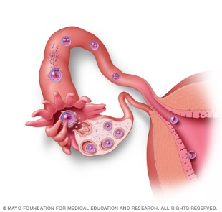
Slide A

Slide 5
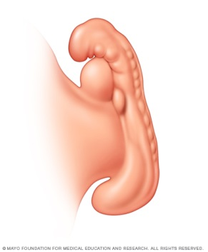
Slide B

Slide 6
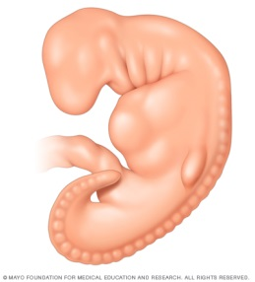
Slide C

Slide 7
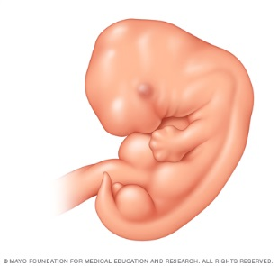
Slide D

Slide 8
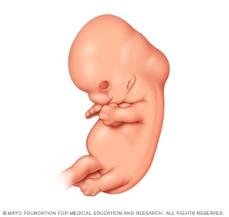
Slide E

Slide 9
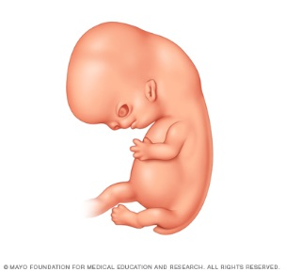
Slide F

Slide 10
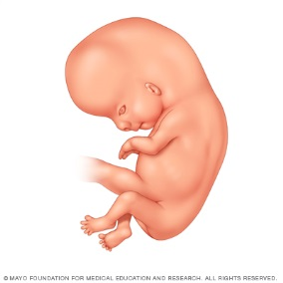
Slide G

Slide 11
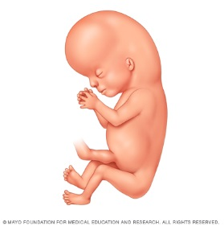
Slide H

Slide 12
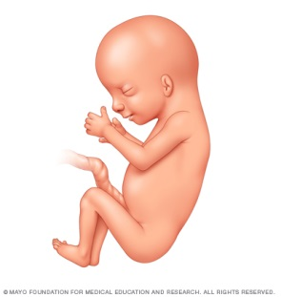
Slide I

Slide 13
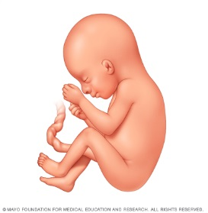
Slide J

Slide 14
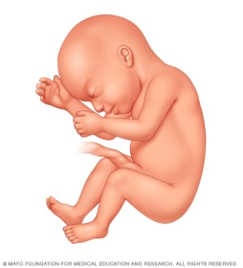
Slide K

Slide 15
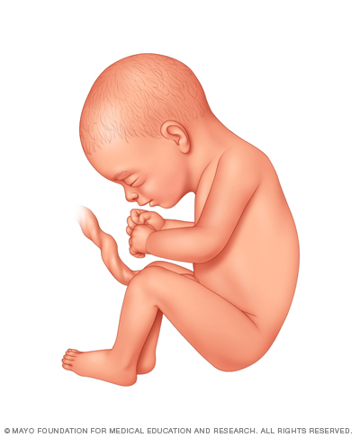
Slide L

Slide 16
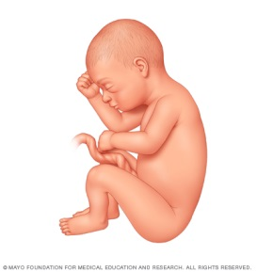
Slide M

Slide 17
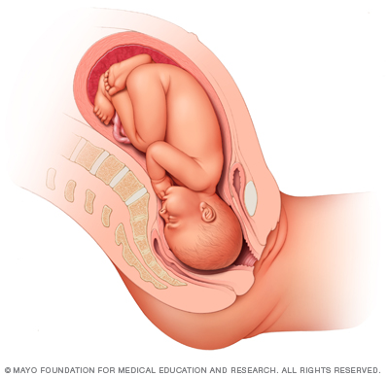
Slide N

Slide 18
Age?

Slide 19
How Old?
Predict the age of each of the images
and place them on a timeline.
(2) Record your justification for your
predicted age.
(3) Compare your predicted age to the
actual age. Move the images on the
timeline as necessary.
Note: These are actual ages of the baby based on conception, not the often reported gestational age.

Slide 20
Slide A
1 WEEK

Slide 21
Slide B
3 WEEKS

Slide 22
Slide C
4 WEEKS

Slide 23
Slide D
5 WEEKS

Slide 24
Slide E
6 WEEKS

Slide 25
Slide F
7 WEEKS

Slide 26
Slide G
8 WEEKS

Slide 27
Slide H
10 WEEKS

Slide 28
Slide I
14 WEEKS

Slide 29
Slide J
19 WEEKS

Slide 30
Slide K
23 WEEKS

Slide 31
Slide L
27 WEEKS

Slide 32
Slide M
31 WEEKS

Slide 33
Slide N
38 WEEKS

Slide 34
How Old?
Compare your predicted ages to the actual ages. How close were they? Why do you think this was so?
(2) How much time is there between each of the pictures? Why do you think the pictures were provided at these time intervals?

Slide 35
Length
Investigate how quickly the baby actually grows in length during its early weeks. Refer to the Interactive Prenatal Development Timeline on EHD.org¹ for help with determining baby lengths at multiple points of gestation. Use a ruler to cut pieces of string to represent the length of the baby during these weeks of growth. What do you notice about the growth rate of the baby?
¹ Measurements can be found at ehd.org/science_main.php?level=b&-submit1.x=48&submit1.y=9&ops=&re=on&L1=1&L2=0.

Slide 36


