Slide 1
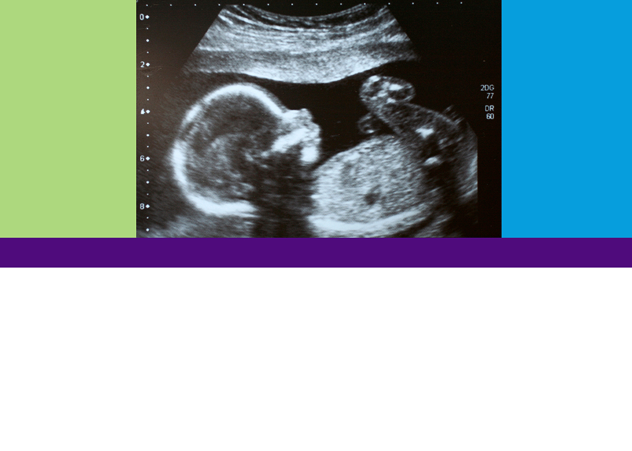
What is This?
Looking at Life in the Womb
TEEN EDITION
What Does Scientific Reasoning Say?
MODULE 3

Slide 2

Objective:
Reflect metacognitively and communicate on when life begins through the process of scientific argumentation, using evidence to support your reasoning.

Slide 3

Definition Study
Define the following words:
zygote
embryo
fetus
baby

Slide 4
Frayer Model

Slide 5
What’s the Argument Here?
What socio-scientific issue is in question?
What scientific question does this address?
Answer the questions below to identify the scientific argument:
What is the scientific claim? (Hint: A scientific claim is an answer to the scientific question.)
What scientific evidence is provided? (Hint: Scientific evidence is data and observations that support the claim.)
What reasoning supports the claim? (Hint: Reasoning describes how an underlying scientific concept connects the evidence to the claim. The reasoning could be in these lessons, or you may have to use your background knowledge about science to develop reasoning.)
Consider the scientific argument and complete the table below. Which criteria (factors) can
you comment about for the argument? For each criterion that is relevant, indicate whether
the scientific argument is strong or weak for that criterion and explain why.

Slide 6
Evaluating the argument (adapted)
State the claim for the argument:
Criterion (factor) | Strength (Strong or Weak) | Explain why the scientific argument is strong or weak for each criterion you list.

Slide 7


