Slide 1
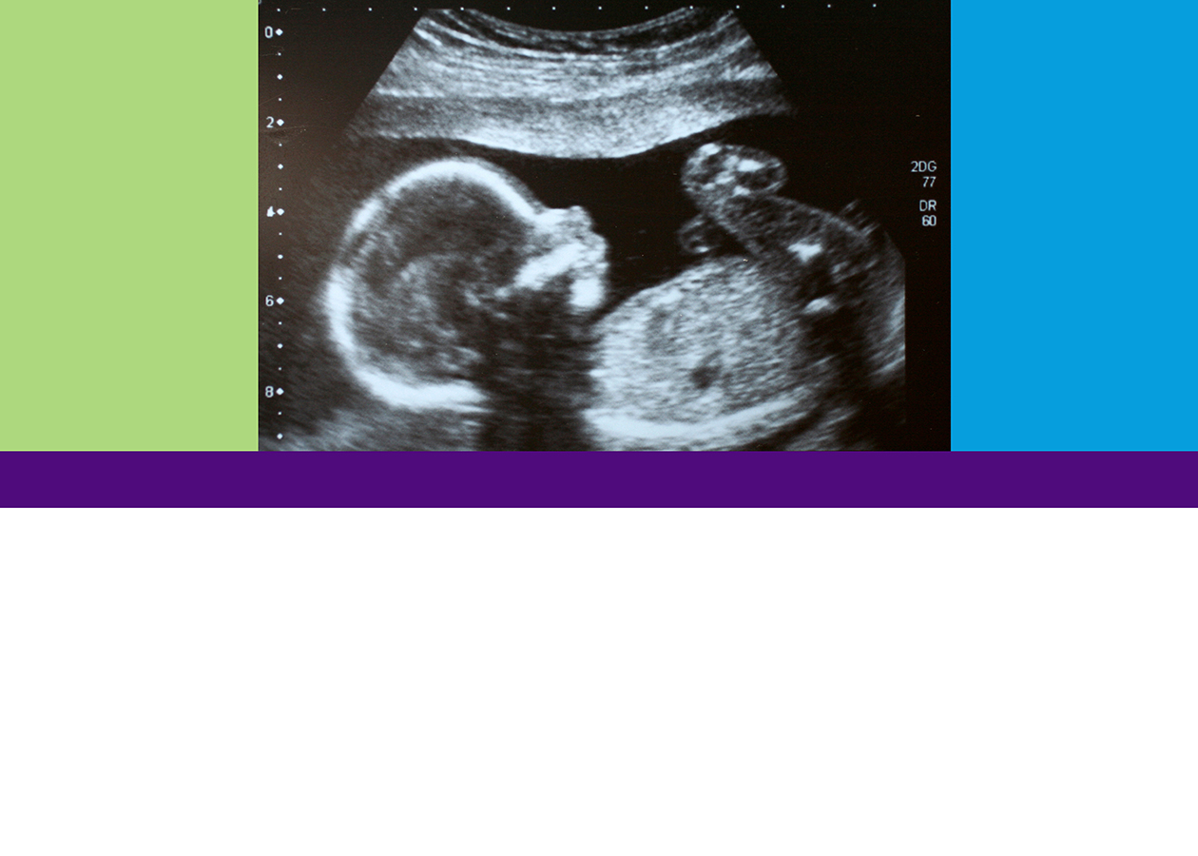
What is This?
Looking at Life in the Womb
TEEN EDITION
What Does the Ultrasound Say?
MODULE 2

Slide 2

Objective:
Examine the “live” growth and development of a human being.

Slide 3

Ultrasound — What Can You See?
First Trimester
Second Trimester
Third Trimester
Copy here …
Copy here …
Copy here …
What I know now that I didn’t know before I saw this ultrasound:

Slide 4


