Slide 1
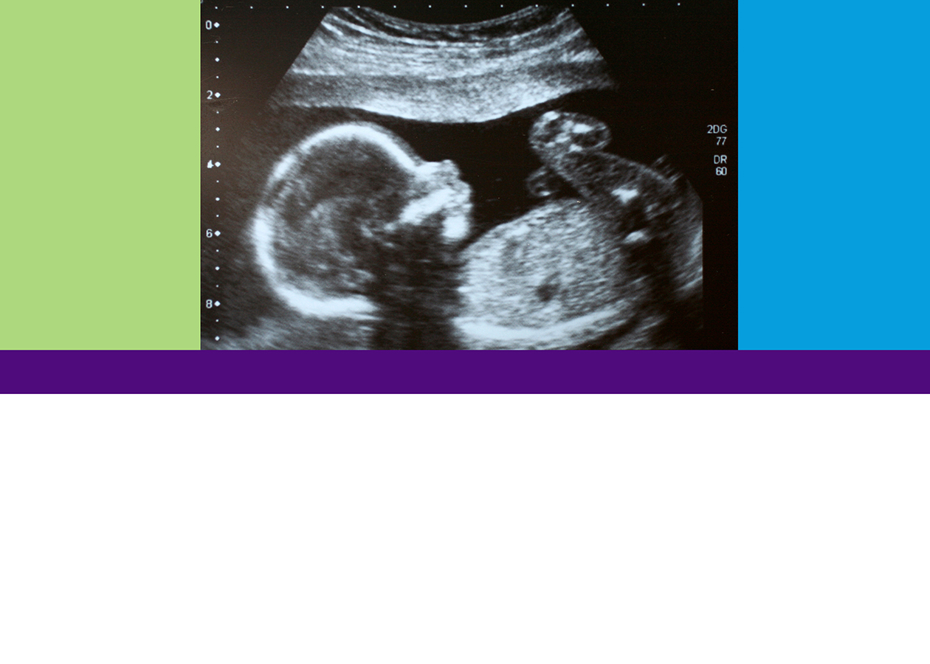
What is This?
Looking at Life in the Womb
TEEN EDITION
What Does the Word of God Say?
MODULE 5

Slide 2
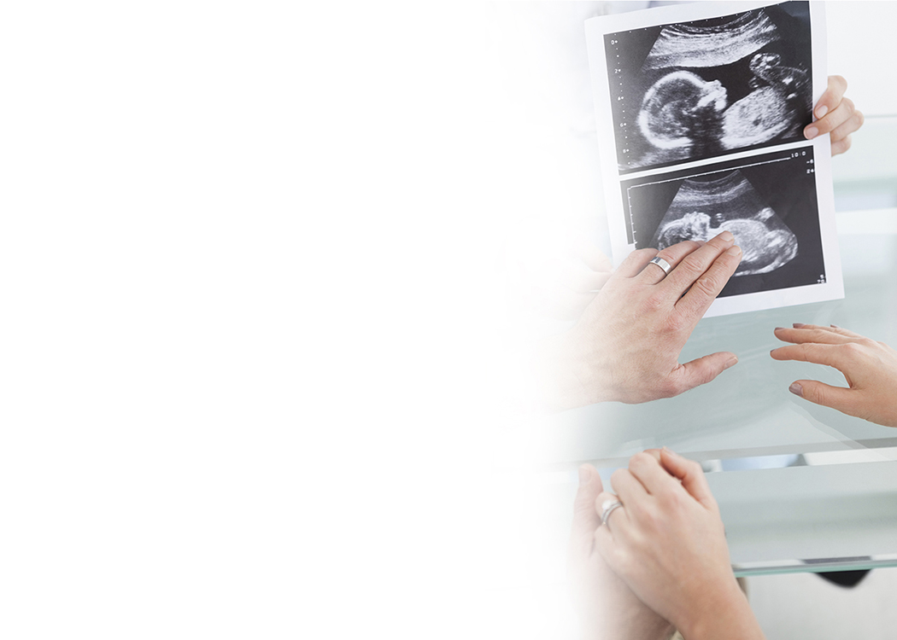
Objective:
Explore what the Bible says about the sanctity of human life.

Slide 3
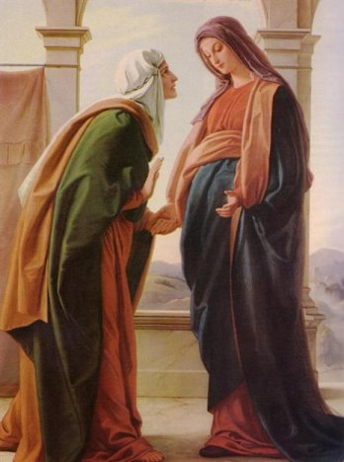
The Meeting of the Babies

Slide 4
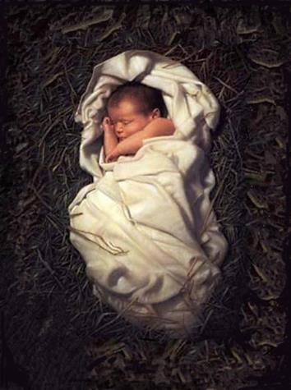
The Incarnation:
God Became an Embryo!

Slide 5
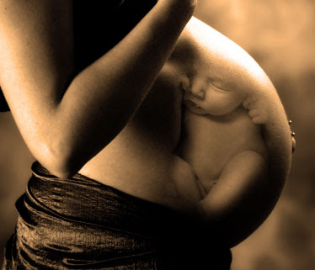
So What About Me?

Slide 6
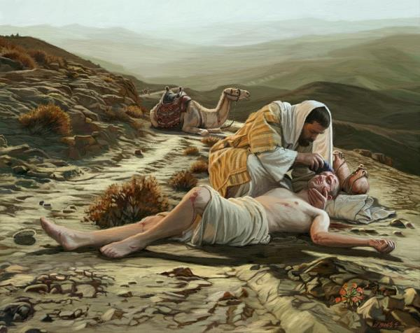
And Who Is My Neighbor?

Slide 7
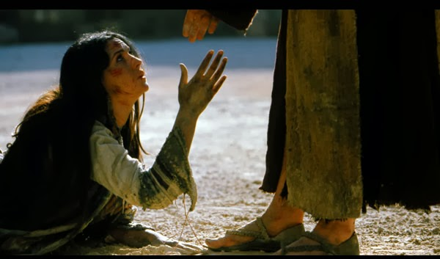
Neither Do I Condemn You

Slide 8
Module 5
What is This?
Looking at Life in the Womb
TEEN EDITION
What Does the Word of God Say?
MODULE 5
Additional Activities

Slide 9
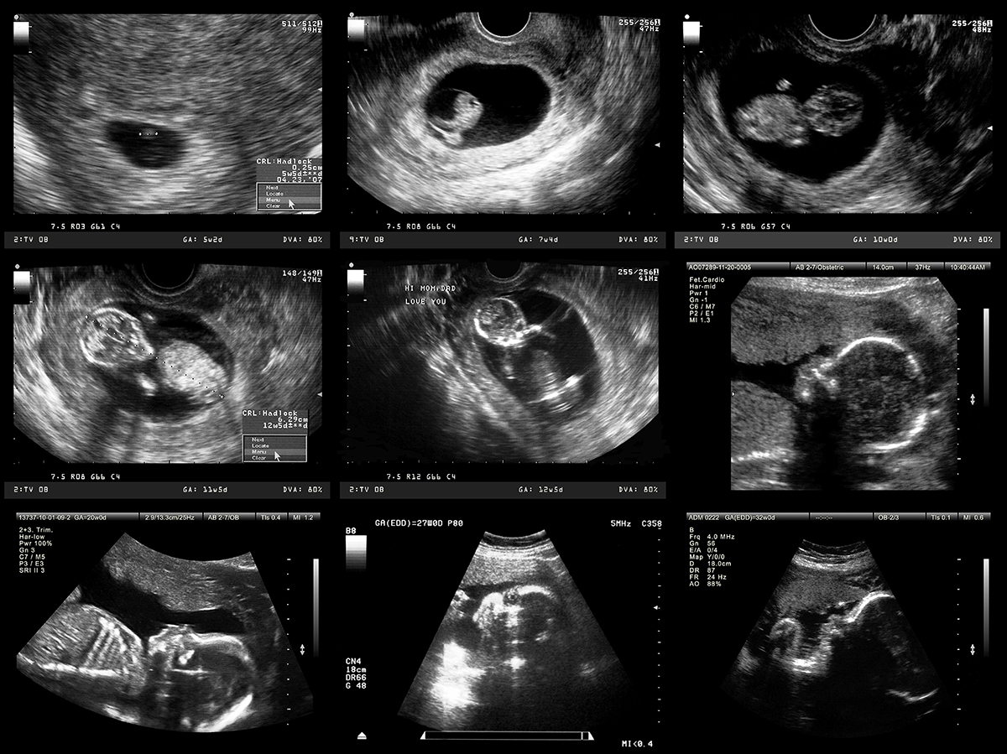
Silent No More Awareness
silentnomoreawareness.org/testimonies

Slide 10
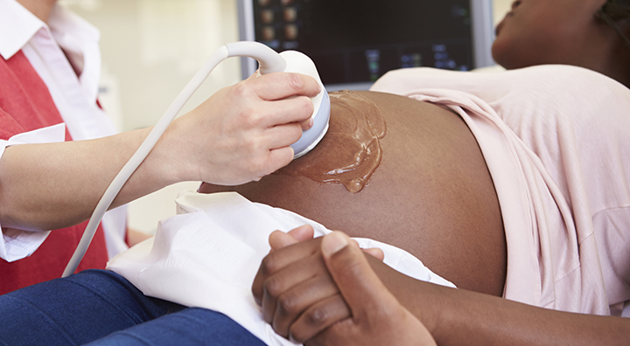
ELCA Social Statement on Abortion

Slide 11


